Slide 1


Energy market in EU
經濟四 黃心俞
經濟三 黃貴鴻
經濟三 莊承穎
經濟二 黃俊軒
經濟三 洪家為
經濟二 蔡佳宏

Slide 2
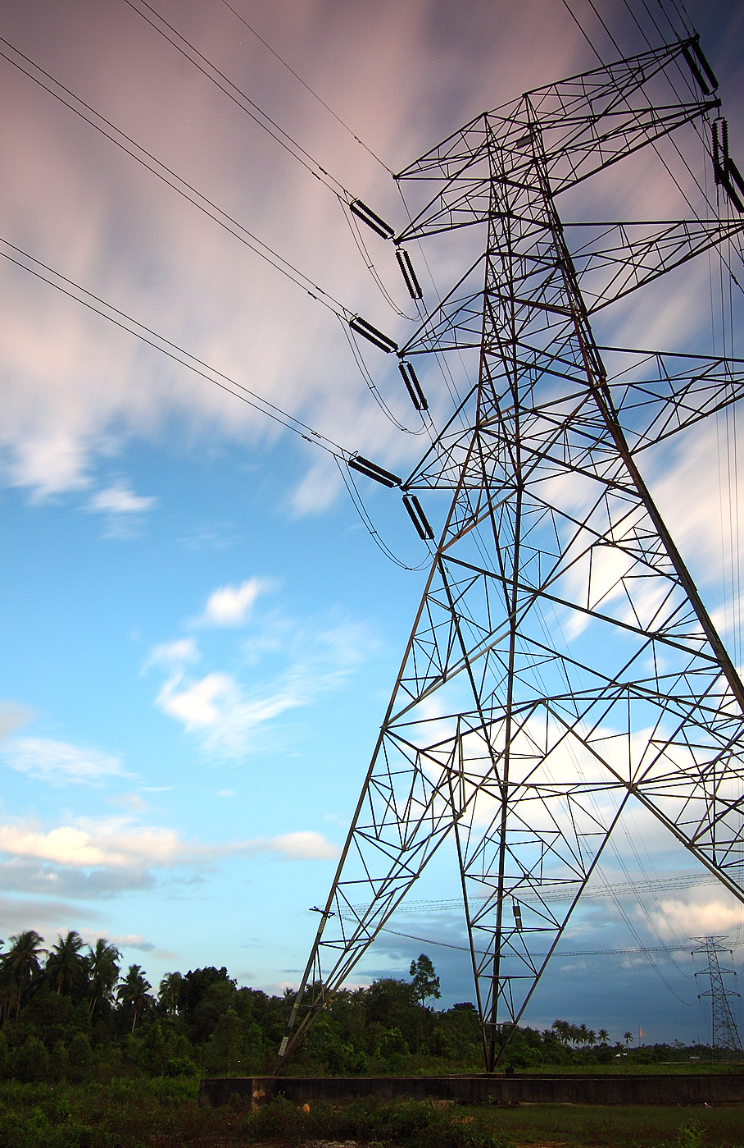
Outline
Supply in EU
Demand in EU
Energy roadmap in 2050
Conclusion

Slide 3
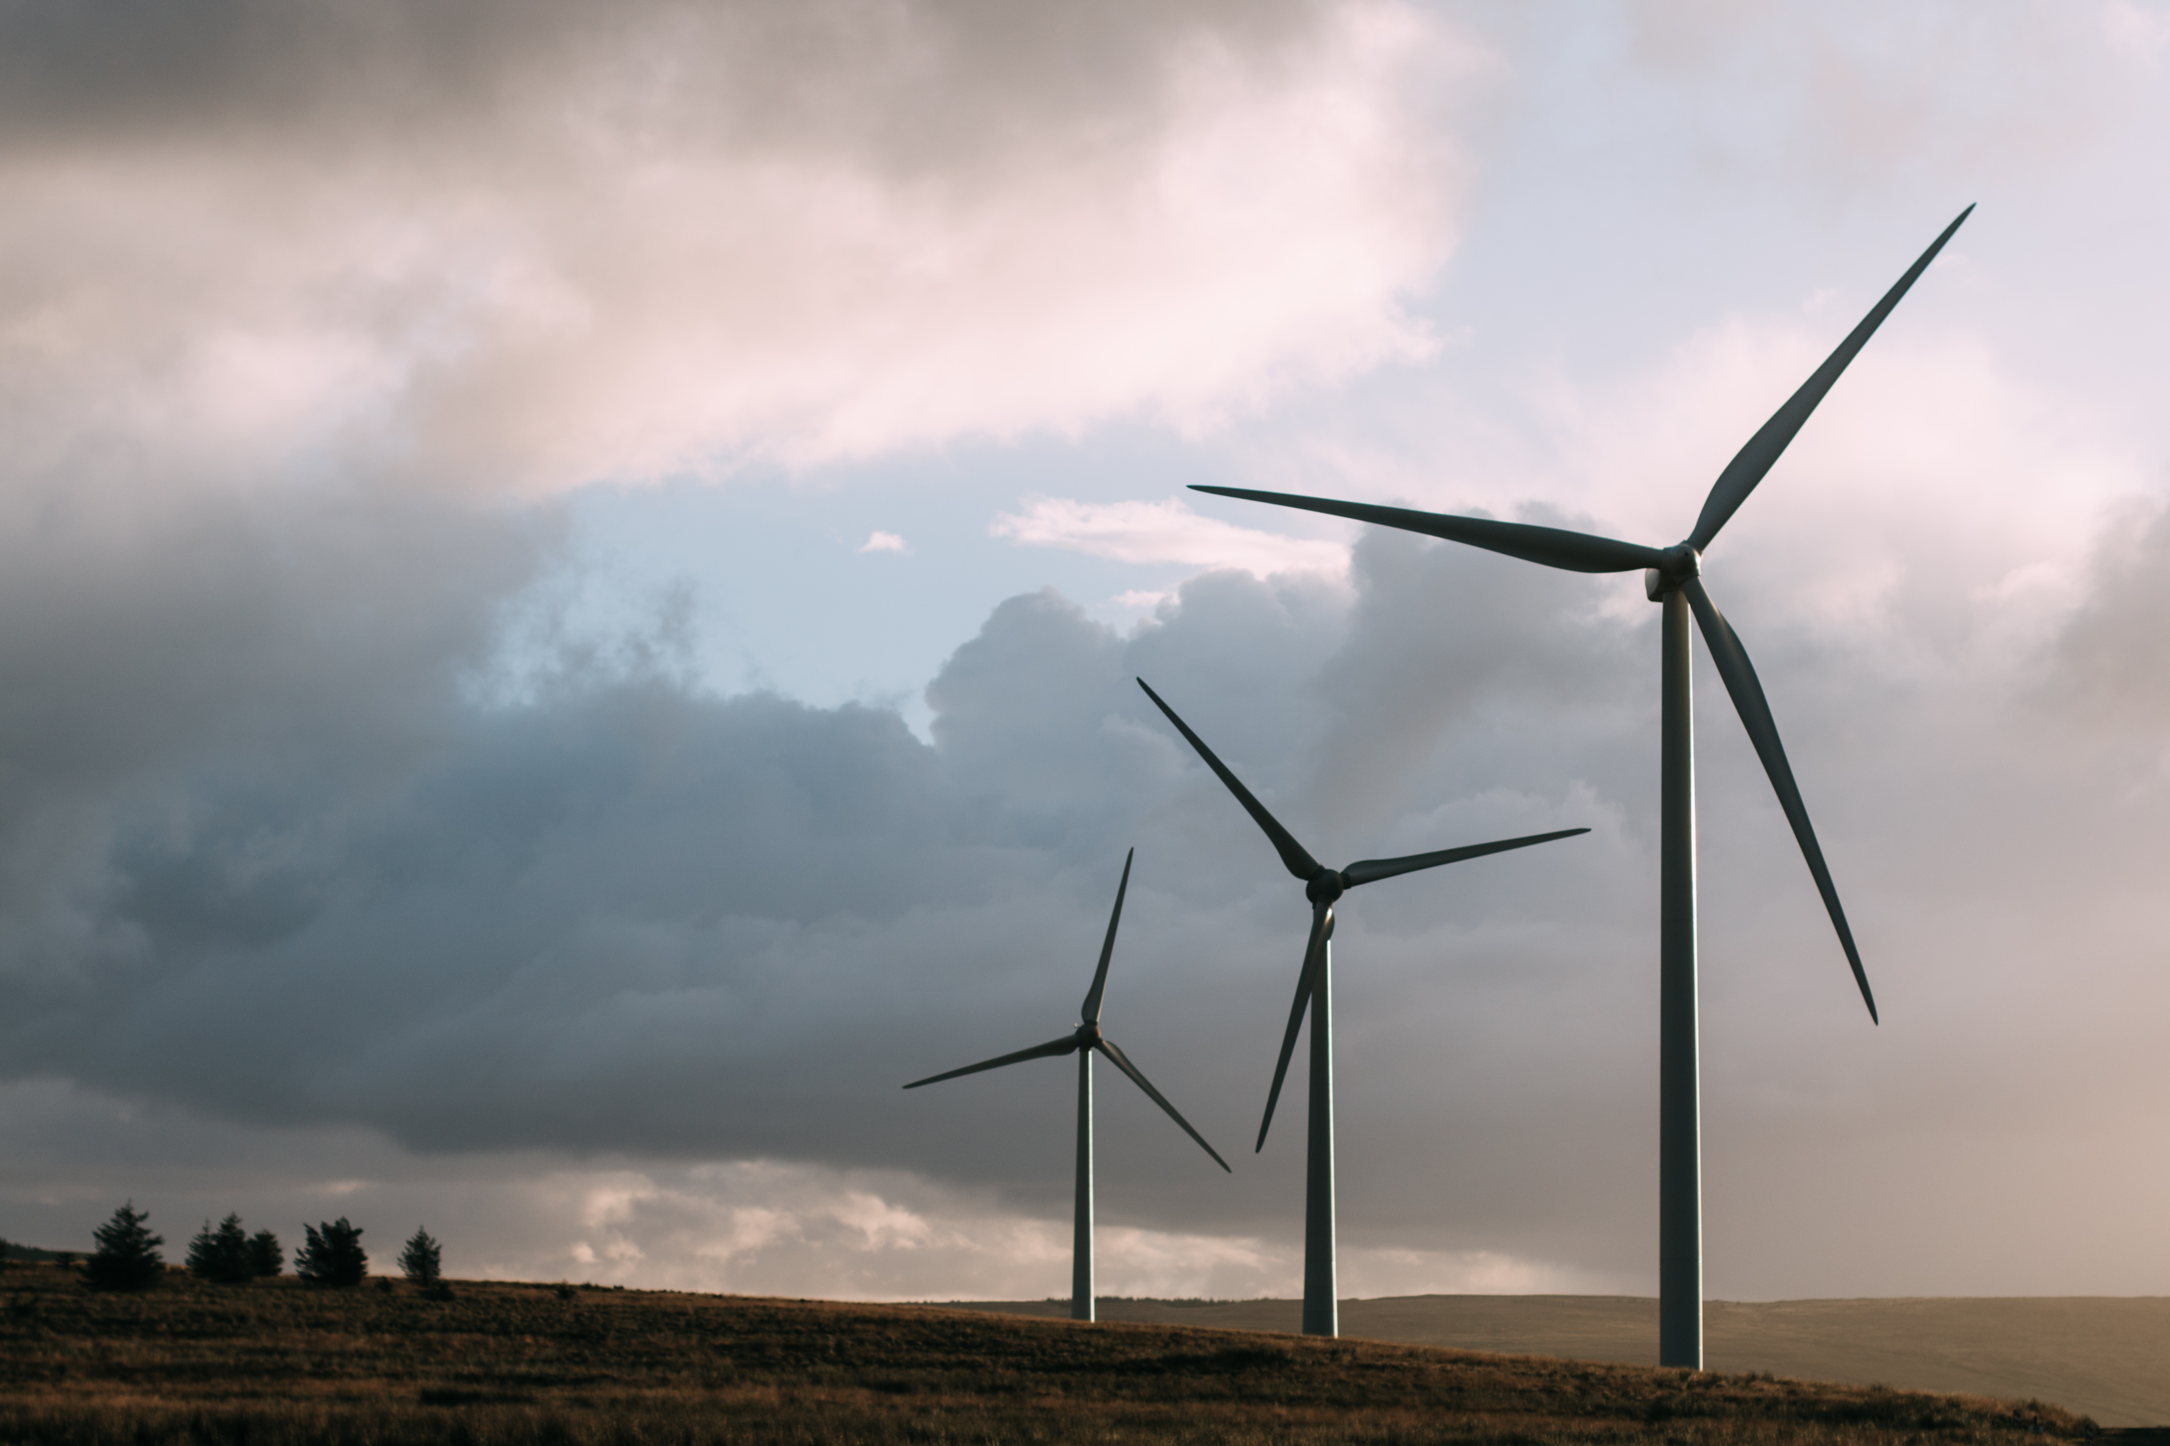
Energy Supply in EU

Slide 4
Energy supply in EU
54 % imported from third countries
46 % of its own energy

Slide 5
Local producer in EU

Slide 6
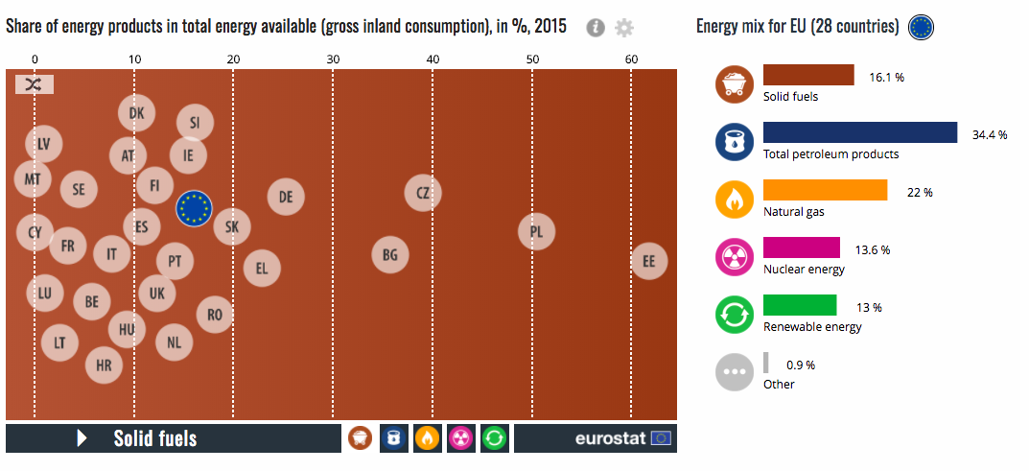
GPI
Share of energy products in total energy in 2015
5 main supply
In 2015, the energy mix in the EU, meaning the range of energy sources available, was mainly made up by five different sources.

Slide 7
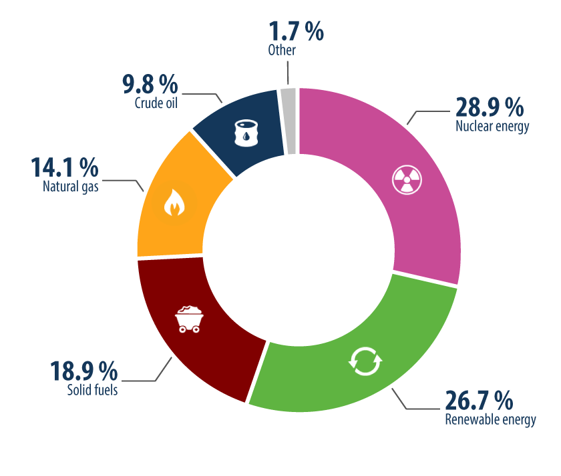
Electricity production by source
solid fuels
natural gas
crude oil
nuclear energy
renewable energy
Notes:
Nuclear energy was the largest contributing source to energy production in the EU. However, the production of energy is very different from one Member State to another. nuclear energy is particularly high in France,Solid fuels have the highest importance in Poland

Slide 8
Share of energy imported
petroleum products : 66 %
followed by gas : 23 %
solid fuels : 10 %

Slide 9
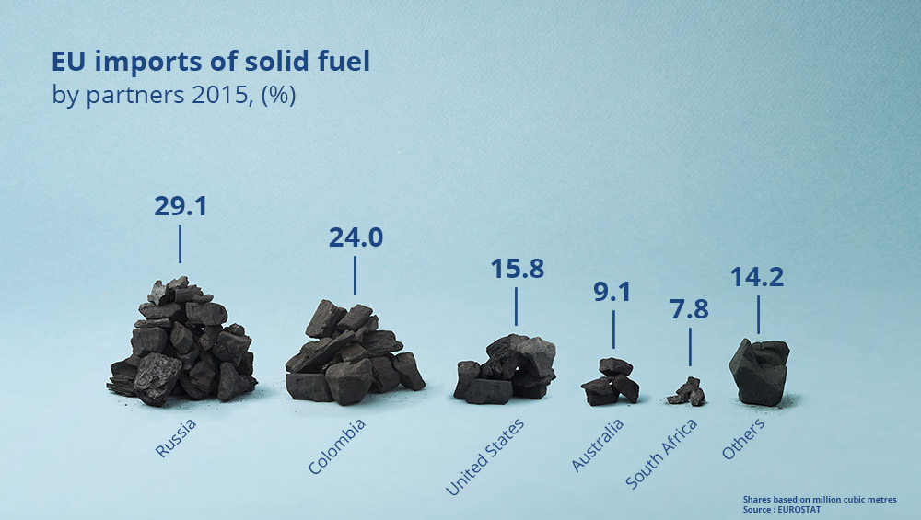
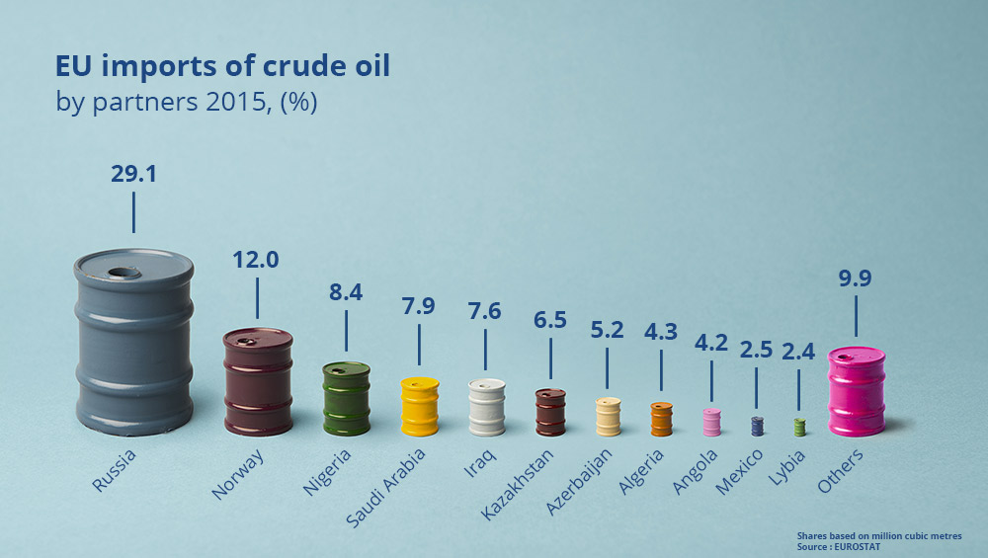
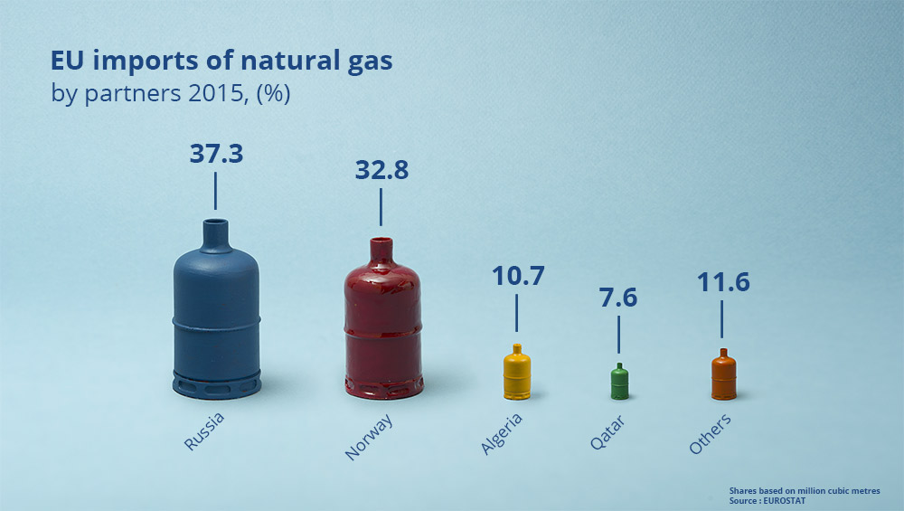
From where do we import energy
Russia is the main EU supplier of crude oil, natural gas and solid fuels
Notes:
In 2015, the main imported energy product was petroleum products.More than 80 % of energy imports are petroleum products in Malta, Cyprus, Greece, Sweden and Romania and around a third or more is gas in Germany and Italy. More than 15 % of energy imports are solid fuels in Slovakia and Germany.

Slide 10
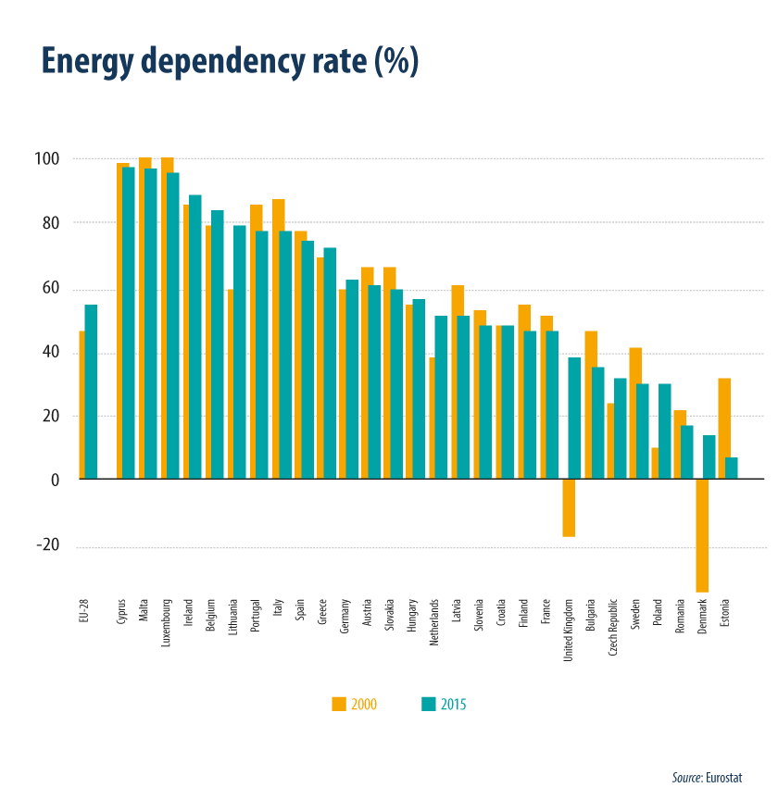
How dependent are we from energy produced outside the EU?
The dependency rate shows the extent to which an economy relies upon imports in order to meet its energy needs. It is measured by the share of net imports in gross inland energy consumption.
Notes:
In the EU in 2015, the dependency rate was equal to 54 %, which means that more than half of the EU’s energy needs were met by net imports.The dependency rate on energy imports has increased since 2000, when it was just 47 %.the EU mainly depends on Russia for imports of crude oil, natural gas and solid fuels, followed by Norway for crude oil and natural gas.

Slide 11
Energy Demand in EU

Slide 12
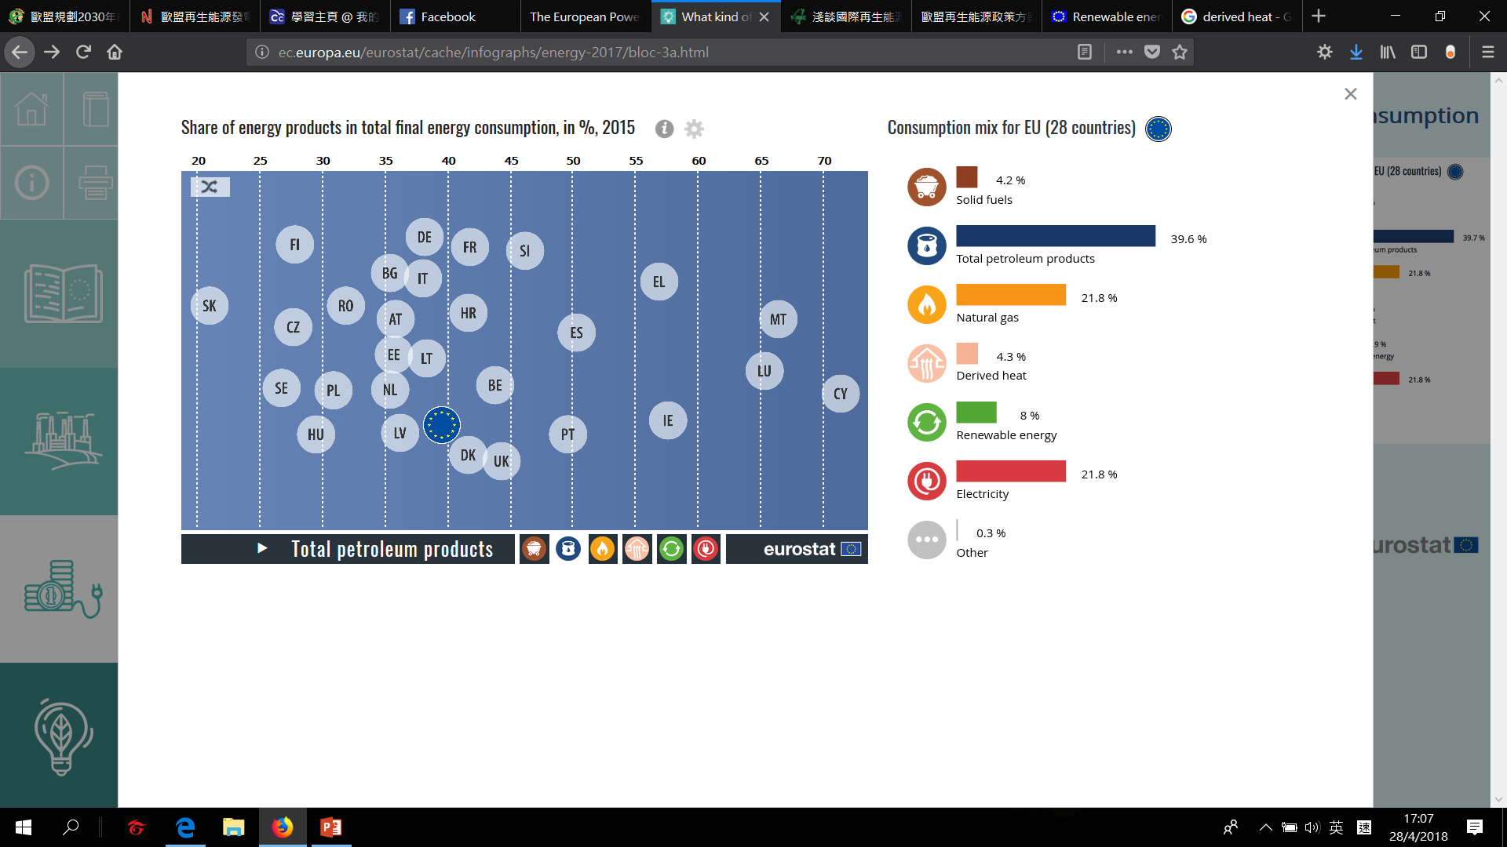
What kind
of energy do we consume？

Slide 13
The difference between
Energy Supply
Energy demand

Slide 14



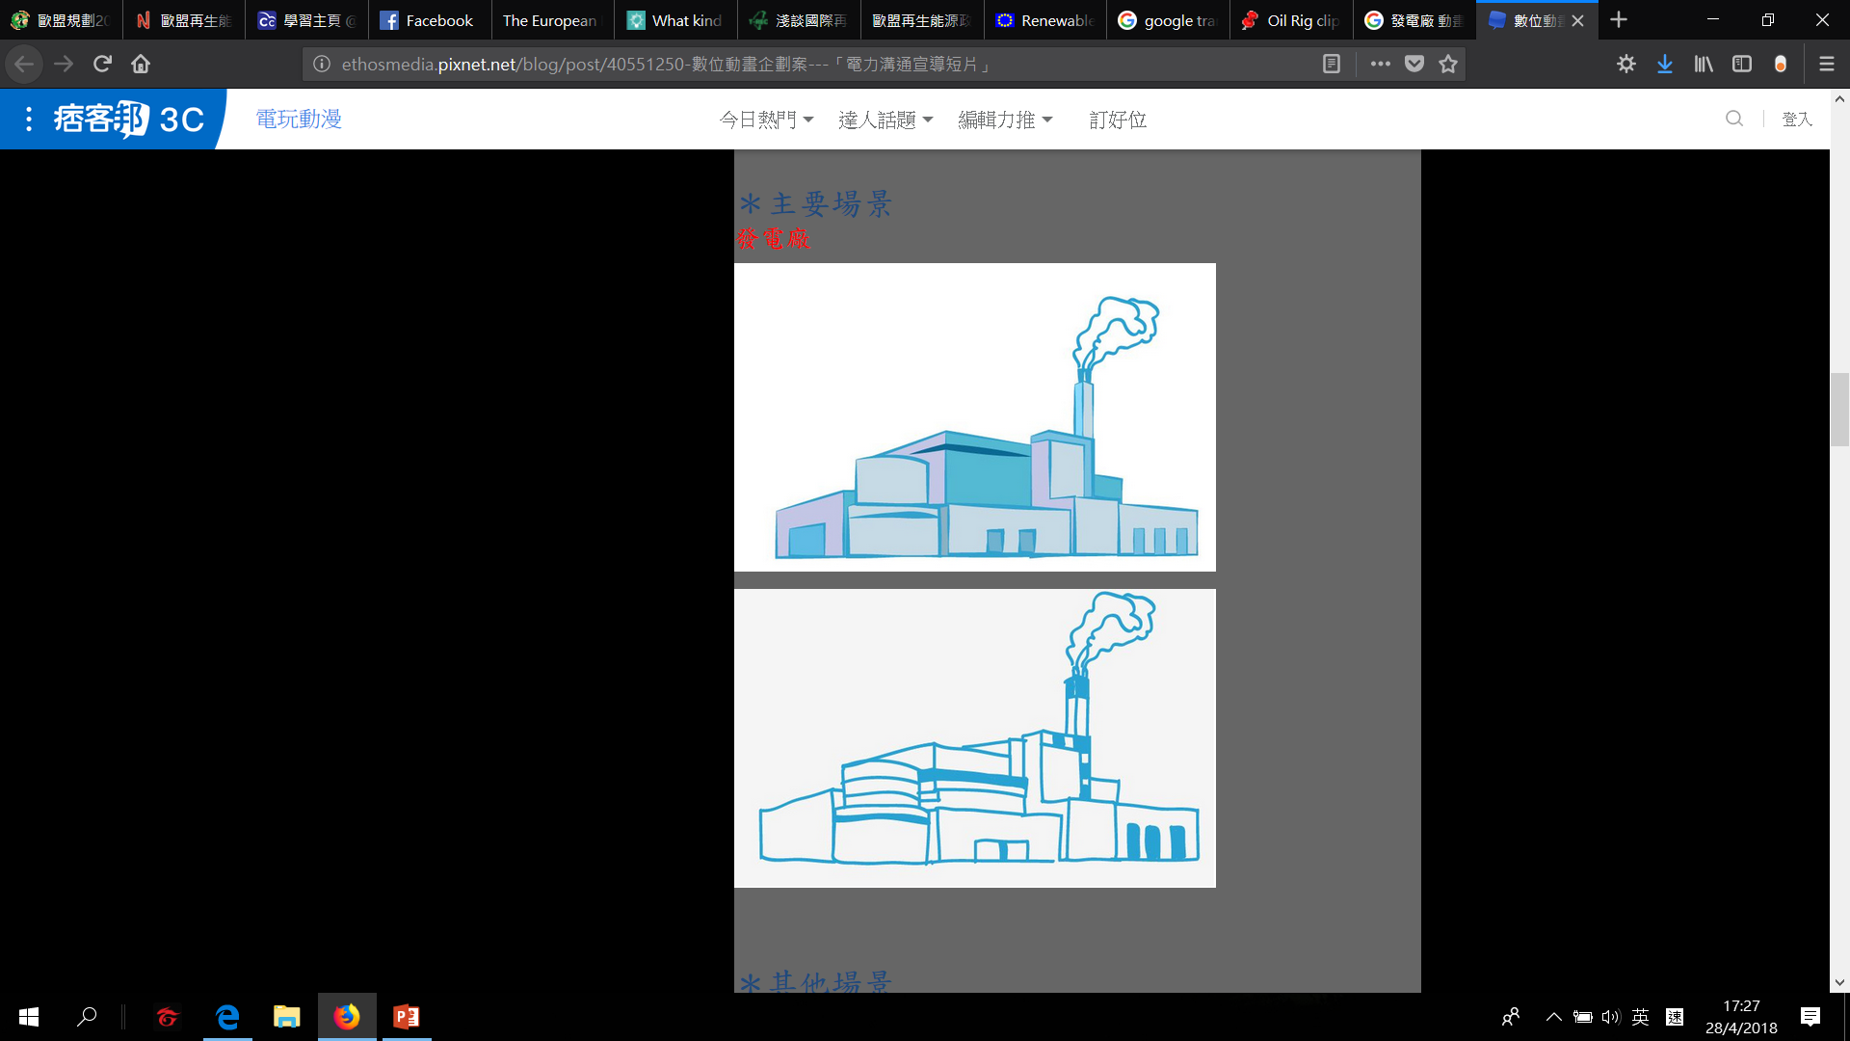
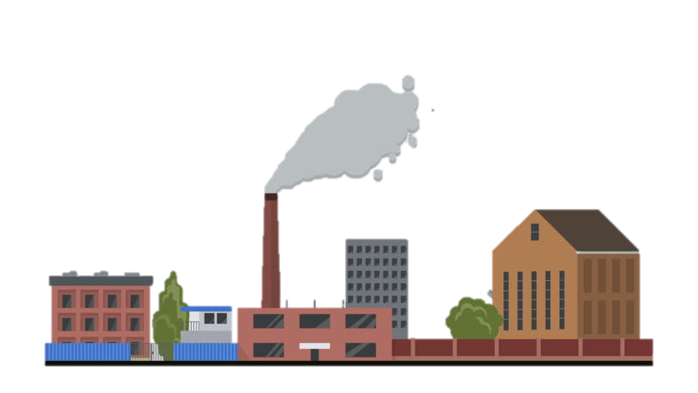
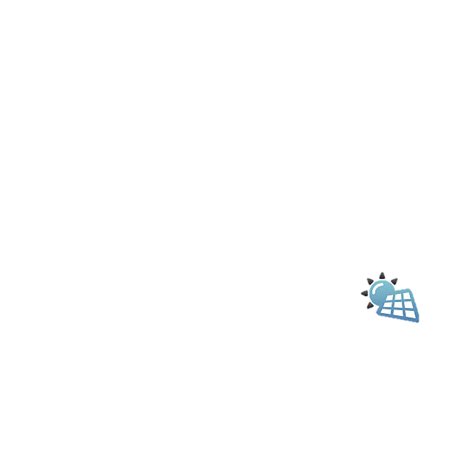






One Thirds of energy losses in transmission and transformation
EU citizens
Two Thirds
industry
Transport etc.
Notes:
Out of the total energy available in the EU, around two thirds are consumed by end users, for example EU citizens, industry, transport etc..

Slide 15
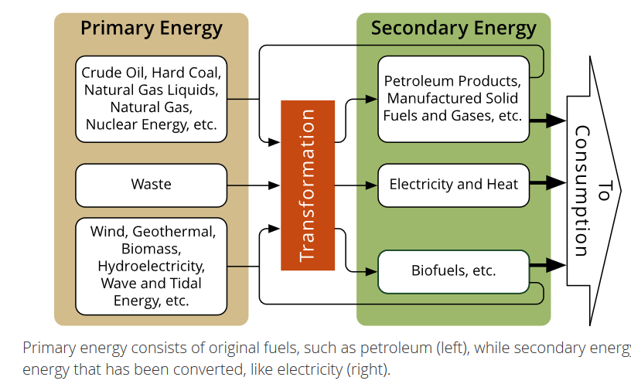
Primary Energy Product
ONE THIRD IS LOST
What is different between them?
Secondary Energy Product
Notes:
Out of the total energy available in the EU, around two thirds are consumed by end users, for example EU citizens, industry, transport etc.. The difference – around one third – is mainly lost during electricity generation and distribution, used to support energy production processes or in non-energy uses (like asphalt or bitumen).
A primary energy product is extracted or captured directly from natural resources, such as crude oil, firewood, natural gas or coal. Secondary energy products (such as electricity or motor gasoline) are produced as a result of a transformation process, either from a primary or from a different secondary energy product. Primary energy consists of unconverted or original fuels. Secondary energy includes resources that have been converted or stored. For example, primary energy sources include petroleum, natural gas, coal, biomass, flowing water, wind, and solar radiation. Those are the fuels that can be mined, reaped, extracted, harvested, or harnessed directly. Secondary energy cannot be harnessed directly from nature; rather, secondary energy is energy that has already been converted. For example, electricity cannot be mined or harvested, though it is available in quick bursts on occasion from lightning. It is generated as a secondary form from primary fuels, like natural gas. Hydrogen is also a secondary form because it is not harvested from nature but produced by reformation of natural gas or electrolysis of water.
It’s not always obvious if a fuel is a primary resource or secondary energy. Sometimes, the same thing may be primary or secondary, depending on its source. For instance, the heat from a geothermal vent could be considered a primary resource, but the heat made from burning fossil fuels is secondary energy.

Slide 16
Petroleum products are the most consumed
In 2015 EU Final Energy Consumption
Derived Heat such as district heating
Solid Fossil Fuels Mostly coal
Direct Use of Renewables Not transform to electricity
Petroleum Products such as heating oil, petrol, diesel fuel
Natural Gas
Electricity Including transform from renewables energy
The real consumption of renewable energy is higher than 8 %, because other renewable sources are included in electricity (e.g. hydropower, wind power or solar photovoltaic).
Notes:
在2015年的歐盟，佔最終能源消費40％的石油產品（如取暖油，汽油，柴油）佔最大的比例，其次是電力和天然氣（各佔22％），直接使用可再生能源（ （8％），固體化石燃料（主要是煤）以及衍生的熱量（如區域供熱）（各自為4％）未轉化為電力，例如木材，太陽熱能，地熱或沼氣用於空間供熱或熱水生產。可再生能源的實際消耗高於8％，因為其他可再生能源包括在電力（如水電，風力發電或太陽能光伏）中。 在歐盟成員國內，最終的能源消費格局差異很大。石油產品在塞浦路斯，馬耳他和盧森堡的最終能源消耗量中超過65％，而荷蘭，匈牙利和斯洛伐克的天然氣佔30％以上。可再生能源在拉脫維亞，芬蘭和瑞典達到20％以上，而瑞典和馬耳他的電力消耗則佔其最終能源消耗的30％以上。

Slide 17
In 2015 EU Sectors Consume The Most Energy
The transport sector consumes a third of the final energy consumption in the EU
Notes:
能源是由不同的經濟部門消費的：家庭（住宅部門消耗的能源），運輸（如鐵路，公路，國內航空或內陸運輸），工業，服務業（包括商業和公共服務）以及農業和林業。
縱觀歐盟哪些行業消耗的能源最多，運輸行業（最終能源消費的33％）消耗的能源最多，其次是工業（25％），家庭（25％），服務業（14％）和農業，林業（2％）。

Slide 18
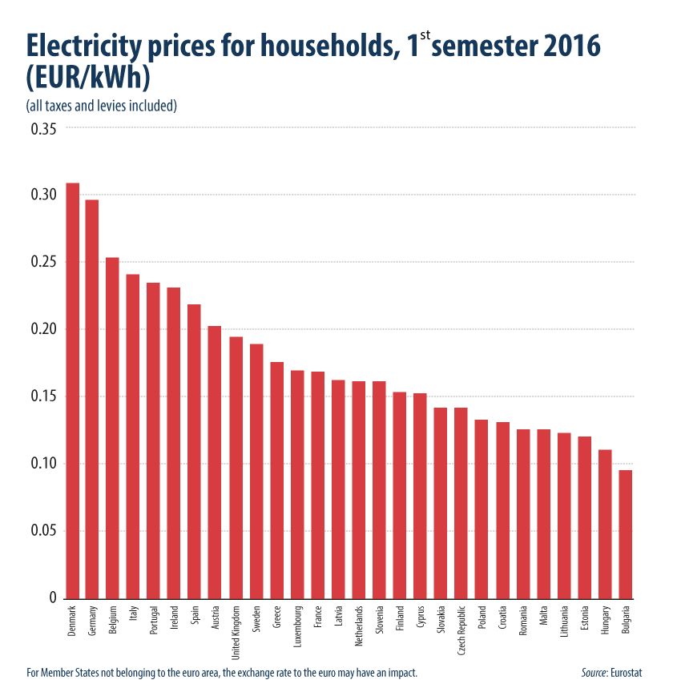
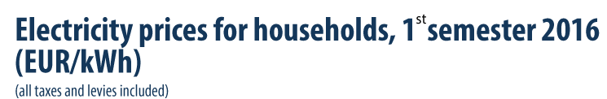
Notes:
For medium size household consumers, electricity prices including taxes and levies were the highest in the first semester of 2016 in Denmark (EUR 0.31 per kWh), Germany (EUR 0.30 per kWh) and Belgium (EUR 0.25 per kWh)

Slide 19
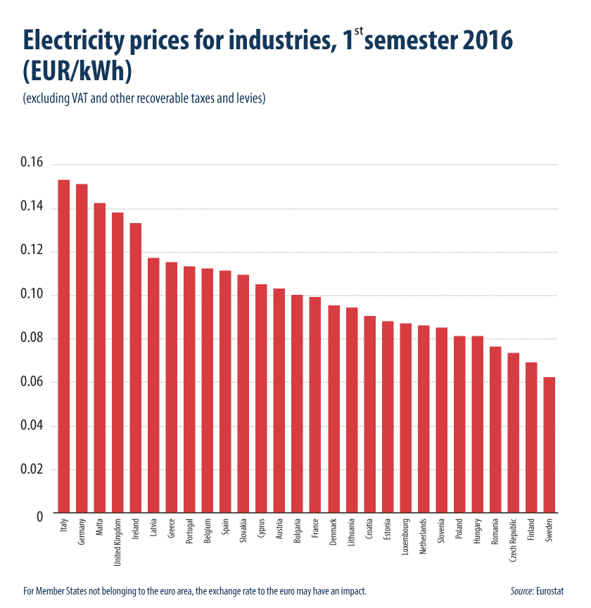
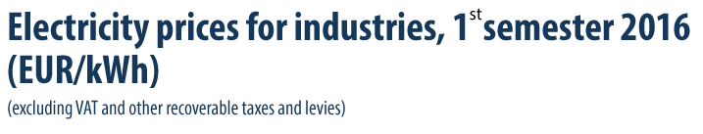
Notes:
For industrial consumers, electricity prices (excluding VAT and other recoverable taxes and levies) in the first semester of 2016 ranged from EUR 0.15 per kWh in Italy and Germany to EUR 0.06 per kWh in Sweden.

Slide 20
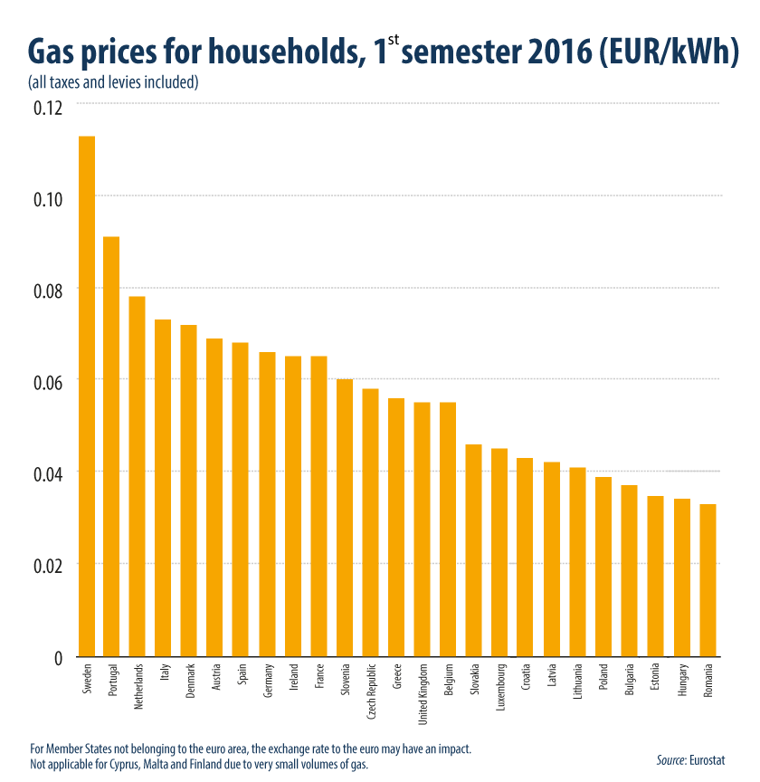
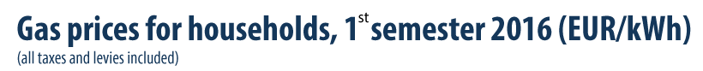
Notes:
For medium size household consumers, natural gas prices including taxes and levies were highest in the first semester of 2016 in Sweden (EUR 0.11 per kWh) and Portugal (EUR 0.09 per kWh) and lowest in Romania, Hungary and Estonia (all EUR 0.03 per kWh)

Slide 21
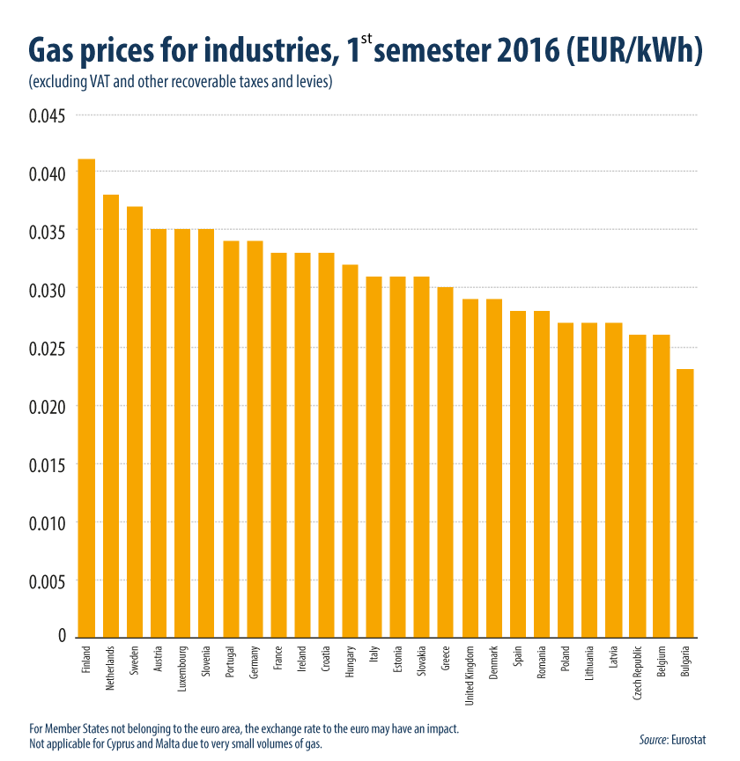
Notes:
For industrial consumers, natural gas prices (excluding VAT and other recoverable taxes and levies) in the first semester of 2016 were highest in Finland (EUR 0.041 per kWh) and the Netherlands (EUR 0.038 per kWh) and lowest in Bulgaria (EUR 0.023 per kWh).

Slide 22
Energy roadmap in 2050
Roadmap for moving to a competitive low-carbon economy in 2050

Slide 23

The EU is committed to reducing greenhouse gas emissions to 80–95 % below 1990 levels by 2050 in the context of necessary reductions by developed countries as a group.(European Council, October 2009)
Identifies key conclusions on ‘no regrets’ options in the European energy system.
Seeks to develop a long-term European technology neutral framework in which these policies will be more effective.
Notes:
1.Scenarios in the ‘Roadmap for moving to a competitive lowcarbon economy in 2050’ suggest that if investments are postponed, they will cost more from 2011 to 2050 and create greater disruption in the longer term.
2. In this decade, a new investment cycle is taking place, as infrastructure built 30–40 years ago needs to be replaced. Acting now can avoid costly changes in later decades and reduces lock-in effects.
3.

Slide 24
Decarbonization scenarios
High energy efficiency
Diversified supply technologies
High renewable energy sources
Delayed CCS
Low nuclear
Notes:
減碳方向
第一點:Political commitment to very high energy savings/Ex. 1.minimum requirements for new buildings 2. high renovation rates of existing buildings 3. establishment of energy savings obligations on energy utilities/***This leads to a decrease in energy demand of 41 % by 2050 as compared to the peaks in 2005–06.
第二點:No technology is preferred; all sources can compete on a market basis with no specific support measures.不獨厚哪一種技術，利用市場經濟
第三點:Strong support measures for RES leading to a very high share of RES in gross final energy consumption (75 % in 2050) and a share of RES in electricity consumption reaching 97 %.
第四點:assuming that carbon capture and storage (CCS) is delayed, leading to higher shares for nuclear energy with decarbonisation driven by carbon prices rather than technology push.如果減碳不如預期，提升核能，尊重市場經濟
第五點:assuming that no new nuclear is being built resulting in a higher penetration of CCS.

Slide 25
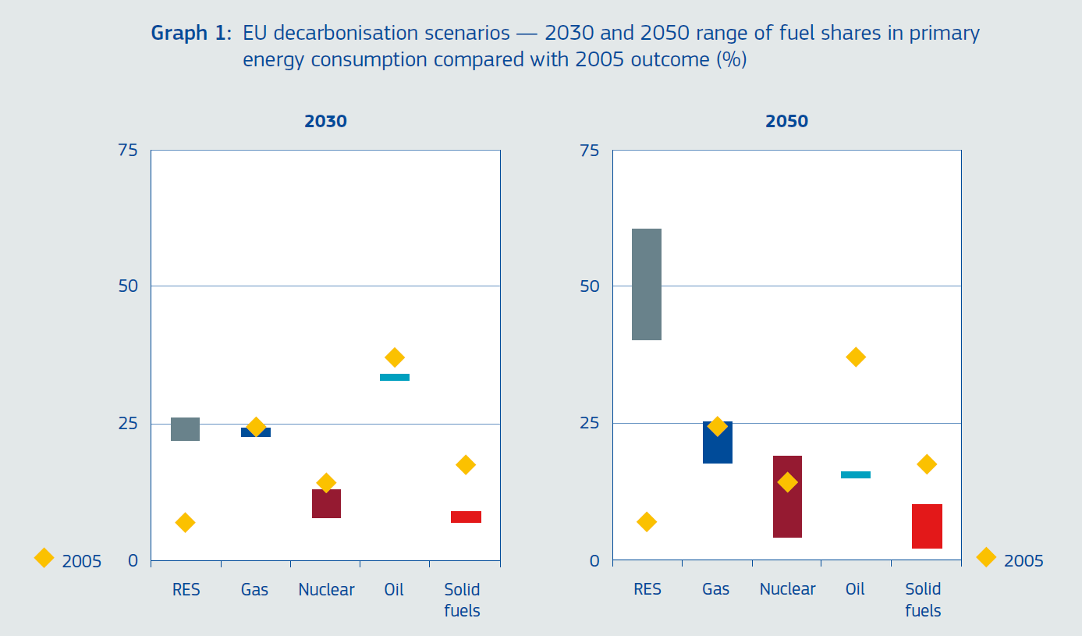
Notes:
黃點是2005的狀況/顏色區間是期待達到的range

Slide 26
Ten structural changes for energy system transformation
(1)Decarbonisation can be less costly than current policies in the long run.
(2)Higher capital expenditure and lower fuel costs
(3)Electricity plays an increasing role
(4)Electricity prices rise until 2030 and then decline
(5)Household expenditure will increase
Notes:
十大結構性的能源體系轉變
第五點和第四點很像，希望家用電在2030前持續漲(比現在增16%)，2030後維持在現在的15%

Slide 27
Ten structural changes for energy system transformation
(6)Energy savings throughoutthe system are crucial
(7) Renewables rise substantially
(8)Carbon capture and storage(CCS) has to play a pivotal role in system transformation
(9) Nuclear energy provides an important contribution
(10) Decentralisation and centralised systems increasingly interact
Notes:
第十點的意思是分散式的能源(如太陽能 風力等地方性能源，無法供大規模使用)可以和集中式能源配合使用(如核能 石油等)，好比有些分散式能源在特定季節或時段不夠的時候要支援

Slide 28
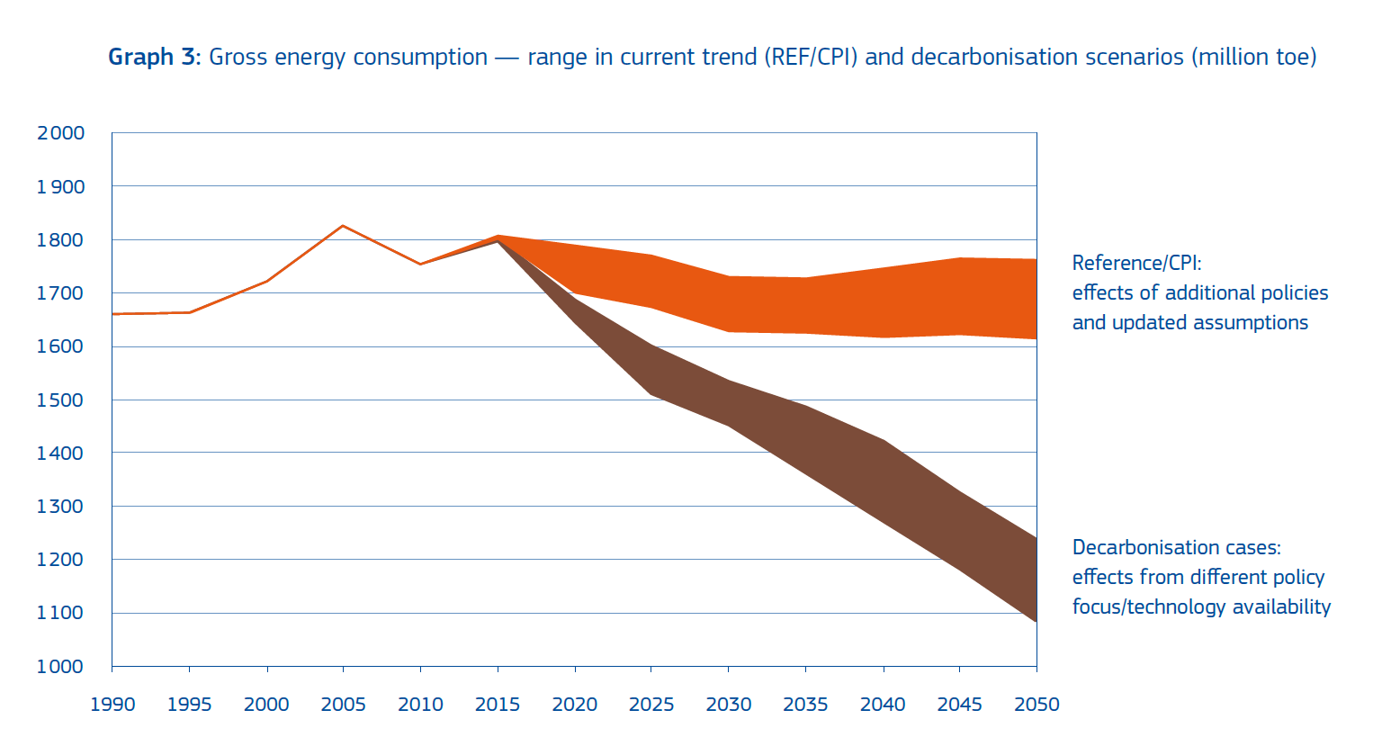
Notes:
第八點的圖，橘色是在維持現有方向下 棕色是CCS的政策趨勢

Slide 29
The way forward
To achieve this new energy system, 10 conditions must be met.
The immediate priority is to implement fully the EU’s Energy 2020 strategy
The energy system and society as a whole need to be dramatically more energy efficient.
Particular attention should continue to be given to the development of renewable energy sources.
Higher public and private investments in R & D and technological innovation
Well-designed market structure instruments and new ways of cooperation are required for the internal energy market
Notes:
1.
2.
3.
4. commercialisation of all low-carbon solutions.
5.
R&D=Research and development

Slide 30
The way forward
(6) Energy prices need to better reflect costs
(7) A new sense of urgency and collective responsibility
(8) There will be no compromise on safety and security for either traditional or new energy sources.
(9) A broader and more coordinated EU approach
(10) Member States and investors need concrete milestones.
Notes:
6.
7. to bear on the development of new energy infrastructure and storage capacities across Europe and with neighbours.
8. The EU must continue to strengthen the safety and security framework and lead international efforts in this field.
9.strengthen international climate action.
10.
結語
On this basis, the Commission will continue to bring forward initiatives, starting with comprehensive proposals on the internal market, renewable energy and nuclear safety next year.

Slide 31
Conclusion

Slide 32

Thanks
for your attention.

Slide 33
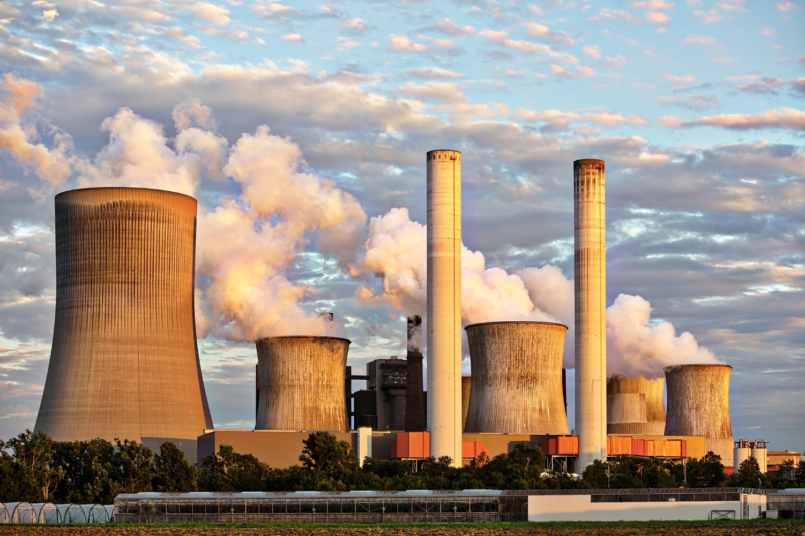

Q&A:

